Slide 1


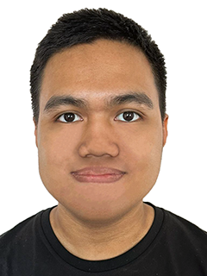

TOMOWORK GOAL SETTING WORKSHEET
NAME
Zikry Suleiman
INSTITUTE
Nanyang Polytechnic
GOAL START DATE
20 MARCH 2023
GOAL COMPLETION DATE
1 JUNE 2023
MY CAREER GOAL IN _5_ YEARS
WORK
Internship, Freelance (Infographic Designer, Illustrator)
LEARNING
Training, Lifelong Learning (Visual Graphic, Motion Graphic)
ACTIVITIES
Volunteer, Community Services (Creative Thinking, Marketing Branding)
5 THINGS I WANT TO ACHIEVE FROM TAP (Please include more than 1 soft skills)
ACTION THAT WILL HELP ME TO REACH MY GOAL
REVIEW
(REVIEW BY 31 MAY MORNING)
1 | Time Management
2 | Stress Management
3 | Organizational
4 | Creativity
5 | Decision-Making
1 | Set time on current task before moving on
2 | Practice mindfulness and use visual aids
3 | Make to do lists and organize materials
4 | Have tons of ideas and visualizations
5 | Prioritize most important tasks first
1
2
3
4
5
COMMENTS FROM FACILITATORS

